Slide 1
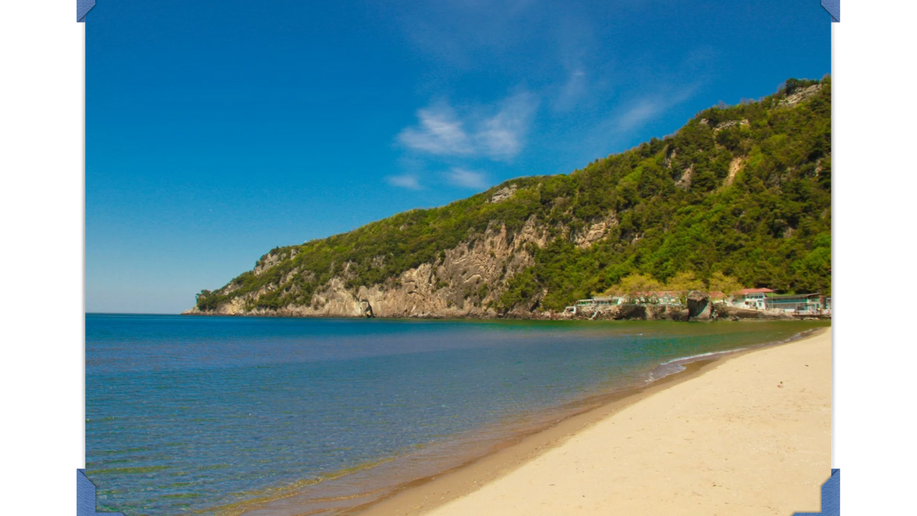
WELCOME TO BARTIN

Slide 2

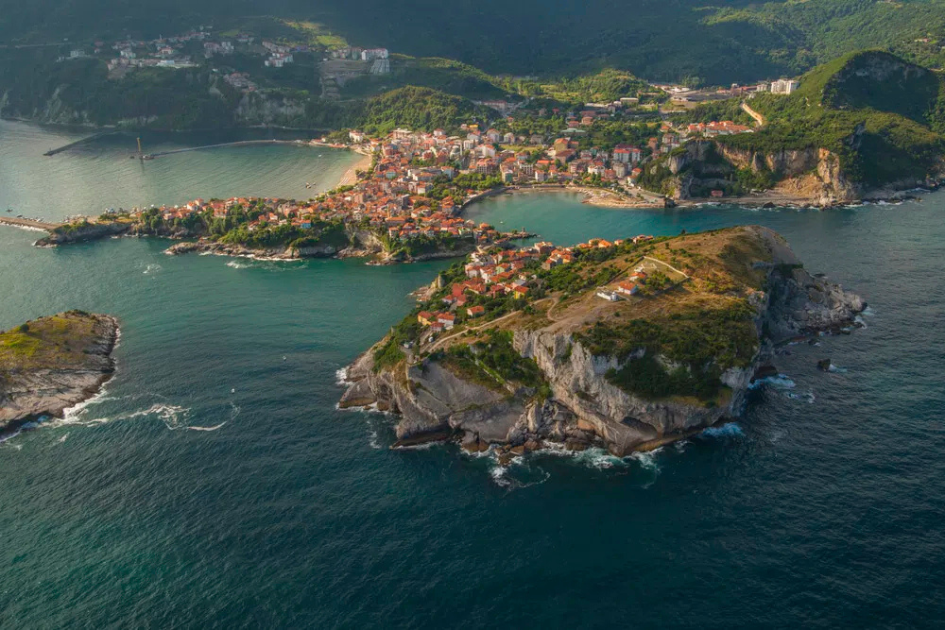
BARTIN UNIVERSITY
Welcome To BARTIN
Dear Erasmus Student,
Welcome to Bartın — a peaceful and green city by the Black Sea!
This Welcome Pack will guide you through everything you need to know: from university facilities to daily life, transportation, cultural tips, and emergency contacts.

Slide 3
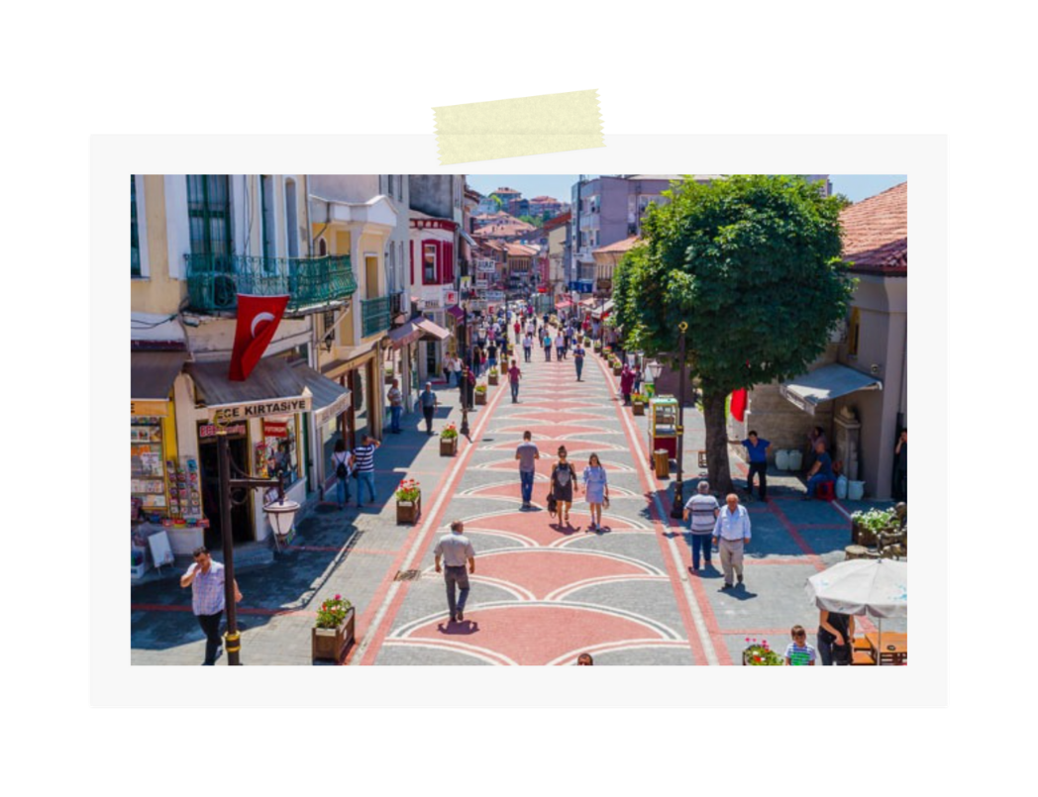
BARTIN UNIVERSITY
📍 About the City
Location
01
Bartın is located in the Western Black Sea Region of Türkiye. It's near the cities of Zonguldak and Kastamonu.
Population
02
The city is home to around 200,000 people.
Nature
03
Bartın is surrounded by green forests and is home to Amasra — a beautiful seaside town you definitely shouldn't miss!
Friendly City
04
Bartın is a student-friendly city, offering a safe and welcoming atmosphere for international students.

Slide 4
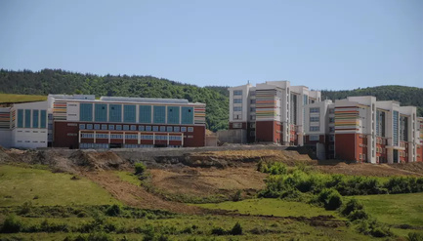
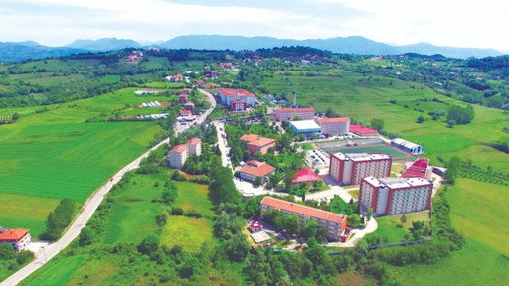
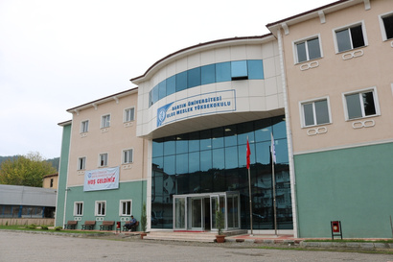
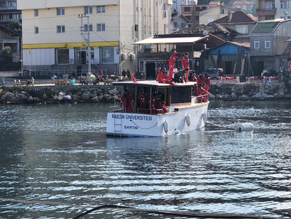
BARTIN UNIVERSITY
🎓 ABOUT BARTIN UNIVERSITY
Founded in 2008, Puplic University
University has approximately 18,000 students, with around 10% of the student of international students.
Have 2 main campuses + 2 vocational schools.
Campuses & Facilities
1. Ağdacı Campus
Location: Close to city center
Key Faculties: Economics, Engineering, Science
Facilities: Labs, library, sports halls, cafeterias
2. Kutlubey (Yazıcılar) Campus
Location: Larger campus ~30 min from city center
Key Faculties: Forestry, Health Sciences, Islamic Sciences, Architecture, Sports
Highlights: Modern buildings, growing green campus
3. Vocational Schools
Ulus & Kurucaşile: Specialized in maritime studies, forestry, and technical programs
01
BARTIN

Slide 5
BARTIN UNIVERSITY
📝 REGISTRATION & OFFICIAL PROCEDURES
📝 Registration & Official Procedures
🎓 Student Affairs Office
The Student Affairs Office is your primary contact point for all academic and administrative matters.
This includes:
Course registration
Student ID cards
Official student certificates (e.g., proof of enrollment)
Transcript requests
Updating student information
Graduation procedures
General academic guidance
📍 Location: Kutlubey Campus
📧 Email: ogrenci@bartin.edu.tr
🕒 Working Hours: Monday–Friday, 08:30–17:00 (excluding public holidays)
🔗 Tip: Always bring your student ID and passport when visiting the office.
BARTIN

Slide 6

BARTIN UNIVERSITY
🛂 Residence Permit for International Students
All international students in Türkiye must apply for a residence permit within 30 days of their entry into the country. This is a legal requirement and crucial for your long-term stay.
🔹 What You Need to Know:
Applications are made online via the Directorate General of Migration Management (DGMM) website.
You’ll receive a temporary residence document while your official permit card is being processed.
Your residence permit must be renewed before its expiration if you plan to continue your studies.
🔹 Required Documents:
Passport and copy of the information and entry stamp pages
Student certificate (from Student Affairs Office)
Biometric photo (4 copies)
Proof of address in Bartın (dorm contract or rental agreement)
Health insurance (valid in Türkiye)
Residence permit application form (filled online)
Payment receipt for the residence permit fee (paid at tax office)
🧭 Assistance Provided By: Erasmus Office
They will guide you through each step, help gather necessary documents, and assist with appointments.
Orientation sessions about the residence permit process are usually held at the beginning of each semester.
📍 Location: Kutlubey Campus
📧 Email: international@personel.bartin.edu.tr
☎ Phone: +90 378 223 5435/5436/5437
🕒 Office Hours: Monday–Friday, 09:00–17:00
BARTIN

Slide 7
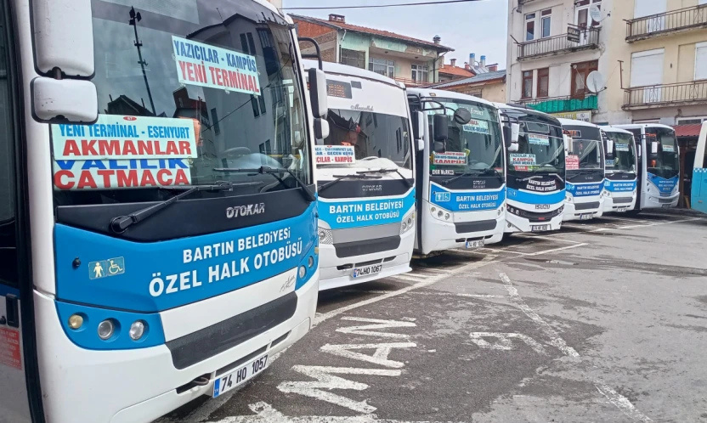
BARTIN UNIVERSITY
🏡 Living in Bartın
🎓 Student Card (Balkart)
Balkart is the official student card in Bartın.
It is used for public transportation (buses & minibuses), university cafeterias, and libraries.
📍 Address (City Center):
Bartın Municipality Public Bus Card Center
Kırtepe Neighborhood, Terminal Street, Bartın City Center
You can apply for your Balkart here by providing your student certificate, ID/passport, and a biometric photo.
Required Documents for Smart Student Card Application:
Student Certificate
1 Passport-Sized Photo
You will receive your Balkart after completing your registration at the university.
Don’t forget to carry it with you — it provides student discounts and is often required for university services.
BARTIN

Slide 8
🏥 Healthcare Services
BARTIN UNIVERSITY
Bartın State Hospital: Public hospital offering affordable healthcare services.
Private Aktıp Hospital: Private hospital with more personalized and faster services (but more expensive).
Private Yaşam Tıp Merkezi ( Hospital): Private hospital with more personalized and faster services.
Pharmacies (eczane) are widely available and usually open until late evening. Emergency pharmacies are available at night and weekends.
BARTIN
🚨 Emergency Number in Türkiye
112
Ambulance / Medical Emergency
Fire Department
Police
💡 You can call 112 for any type of emergency, and they will direct you to the right service.
In case of emergencies, dial 112 to call an ambulance (service is free in Türkiye).

Slide 9
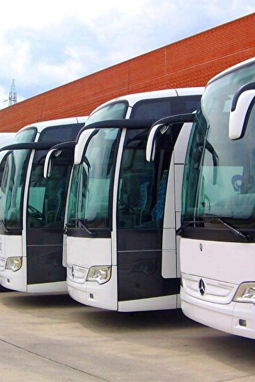
BARTIN UNIVERSITY
🚍 Transportation
Within the City:
Public buses and minibuses (dolmuş) are commonly used.
Balkart is required to use city buses or you can pay it cash.
Taxis are available and affordable for short distances.
Travel to Other Cities:
Istanbul: ~7 hours by bus
Eskisehir: ~6 hours by bus
Ankara: ~4 hours by bus
Zonguldak: ~1.5 hours by bus
Karabuk: ~1.5 hours by bus
Buses operate daily from Bartın Bus Terminal.
City Buses
For Between Cities

Slide 10



🛍️ Shopping & Daily Needs
Where to Shop:
Grocery stores such as Migros, BİM, A101, and Şok are widely available throughout the area.
Bartın has little local AVM’s where you can find everything you need.
Weekly markets (pazar) offer fresh local fruits and vegetables.
Essentials:
Pharmacies, stationery shops, and mobile service stores are easily found
near the campuses.
BARTIN

Slide 11

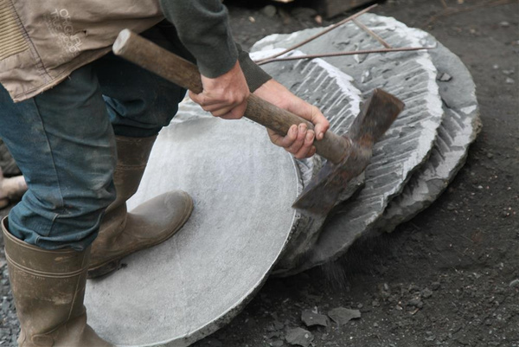
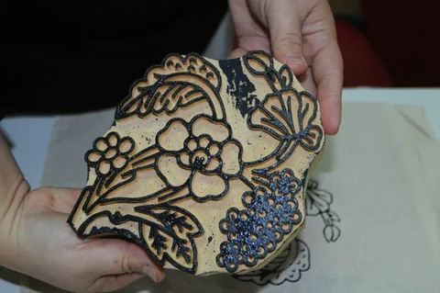
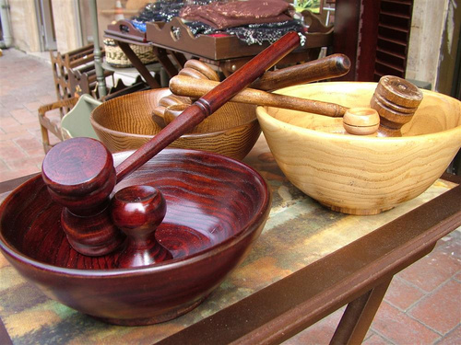
🎭 Cultural Insights
Turkish Culture – What to Know:
Hospitality is very important.
Shoes are taken off when entering a home.
People may be more traditional in small cities — being respectful goes a long way!
People of Bartın are generally warm-hearted and hospitable. Being a small city contributes to strong community ties.
Wood carving, weaving, and basketry are important parts of the city’s culture. Handmade products are frequently seen in Amasra.

Slide 12
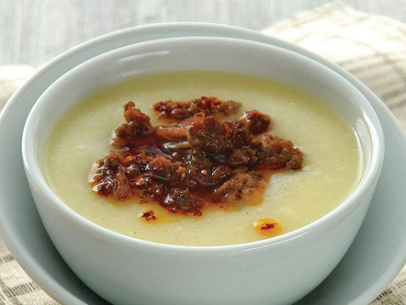

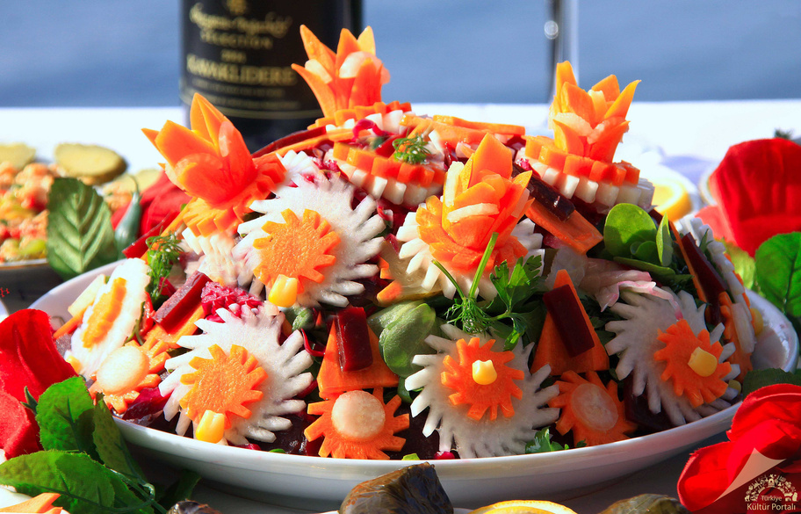

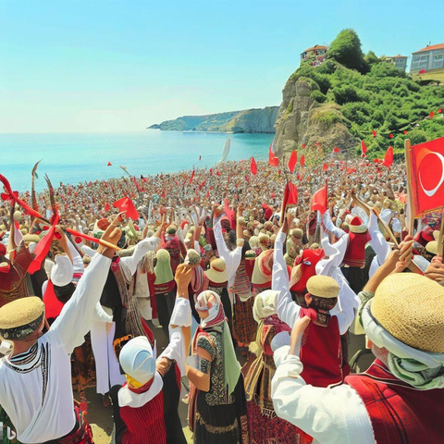
🎭 Cultural Insights
Local Dishes to Try:
Pumpum Soup
Amasra Salad
Katlama (local pastry)
Festivals & Events:
Bartın River Festival
Amasra Culture & Tourism Festival
Folk dances, local music, and handcrafts are part of the experience.
PUMPUM SOUP
AMASRA SALAD
AMASRA FESTIVAL

Slide 13

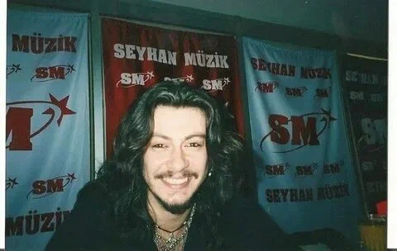
🎭 Cultural Insights
Barış Akarsu – Turkish Rock Musician and Actor (1979–2007)
Biography
Full Name: Barış Akarsu
Birth: June 29, 1979, in Amasra, Bartın, Turkey
Death: July 28, 2007, in Bodrum, Turkey (tragically at age 28 in a car accident)
Occupation: Singer, songwriter, actor
Career
Music Breakthrough: Barış gained fame after winning the Turkish TV talent show “Akademi Türkiye” in 2004, a platform similar to “American Idol.”
Popular Songs:
“Islak Islak”
“Kimdir O”
“Gel Gör Beni Aşk Neyledi”
Acting: Played in the TV series “Yalancı Yarim” (2005–2006), which was well-received in Turkey and increased his fame beyond music.
Legacy
Barış Akarsu is remembered for his energetic stage presence, rock vocals, and his connection to youth culture in Turkey.
Tragic Loss: His sudden death in a car accident shocked fans across the country.
Tributes: Numerous concerts, memorials, and tribute songs honor his legacy; his music remains popular among fans of Turkish rock.
BARTIN

Slide 14
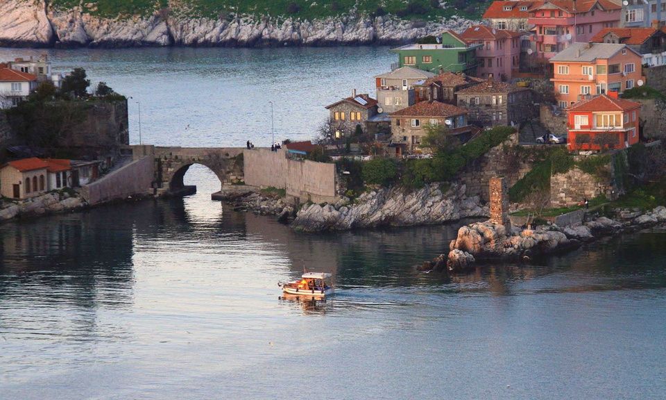
✈️Historical and Touristic Places
1.AMASRA
History:
Amasra boasts a history spanning over 3,000 years, with roots tracing back to the ancient Greek colony of Sesamos. It flourished under Roman and Byzantine rule and later came under Genoese control in the 13th century. In 1460, Sultan Mehmed II the Conqueror incorporated it into the Ottoman Empire.
Key Places:
Amasra Castle: A Byzantine structure expanded by the Genoese, offering panoramic views of the town and sea.
Büyük Liman & Küçük Liman (Big and Small Harbors): Charming harbors lined with cafes and seafood restaurants.
Historical Streets: Wander through narrow alleys adorned with traditional wooden houses.bitbook.netWow Cappadocia
Transportation: From Bartın city center, Amasra is approximately 17 km away. You can reach Amasra by minibus (dolmuş), which operates every 30 minutes during peak seasons and every two hours in winter.
BARTIN

Slide 15
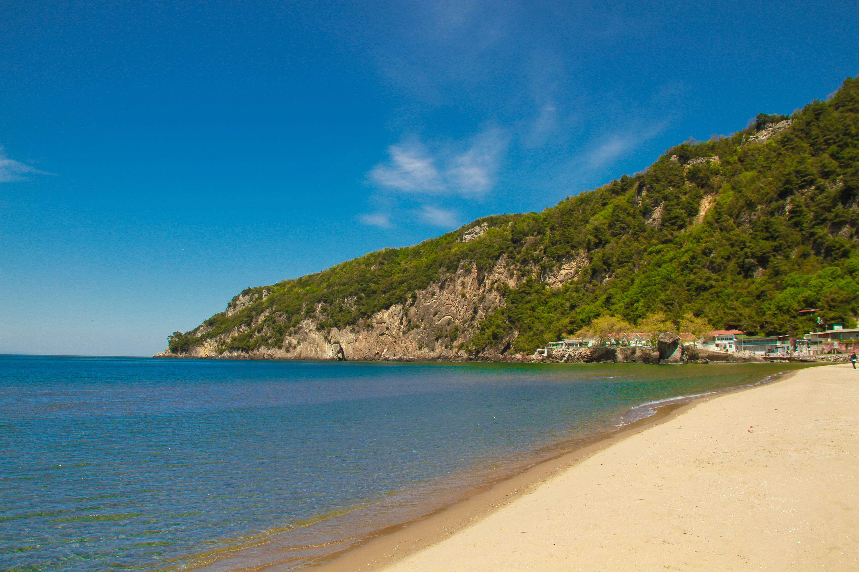
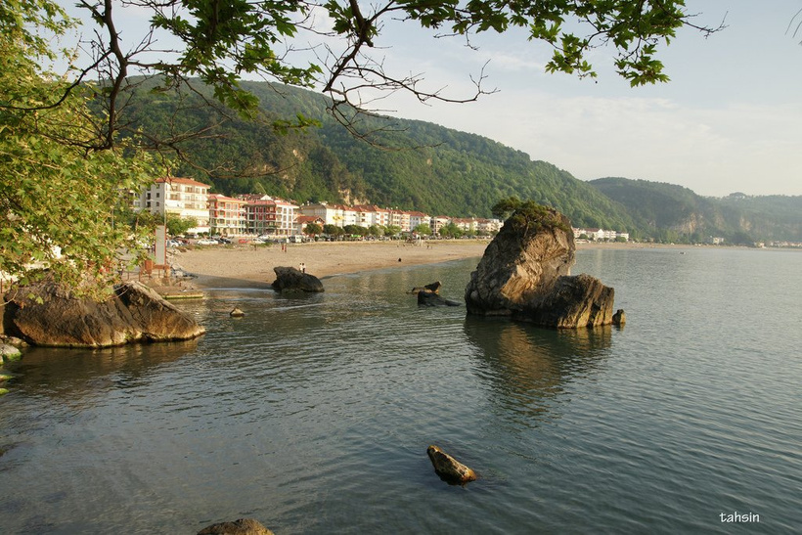
✈️Historical and Touristic Places
🏖️ 2. İnkumu Beach
Overview:
İnkumu is a renowned Black Sea beach destination, known for its golden sands and clear waters, making it ideal for swimming and relaxation.
Transportation:
Located about 17 km from Bartın city center, İnkumu is accessible via local minibuses (dolmuş) departing from the İnkumu bus stop in the city center. The journey takes approximately 15-20 minutes.
BARTIN

Slide 16
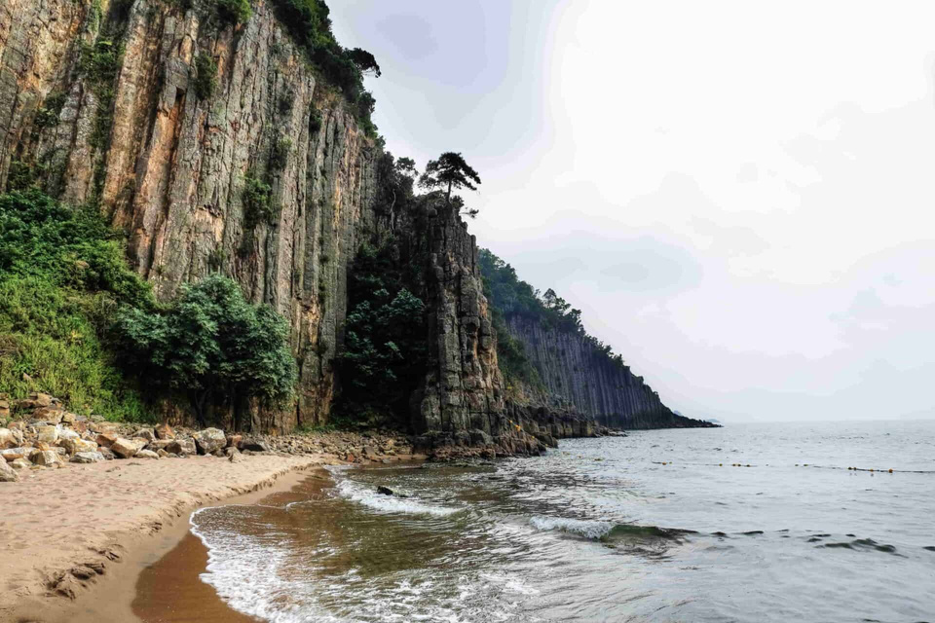
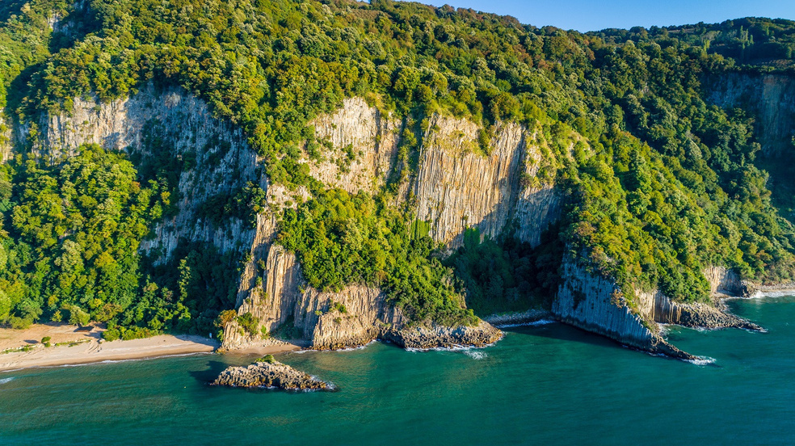
✈️Historical and Touristic Places
🌋 3. Güzelcehisar Lava Columns
History:
The Güzelcehisar Lava Columns are unique geological formations estimated to be 80 million years old. These hexagonal basalt columns were formed by the cooling and crystallization of lava from ancient volcanic activity.
Attractions:
Lava Columns: Marvel at the striking hexagonal basalt formations along the coastline.
Beach: Enjoy the serene atmosphere and clear waters of Güzelcehisar Beach.
Transportation: Güzelcehisar is approximately 30 km from Bartın. While there are no direct minibuses from Amasra, you can reach Güzelcehisar by passing through Bartın. Minibus services are available from Bartın to Güzelcehisar.
BARTIN

Slide 17
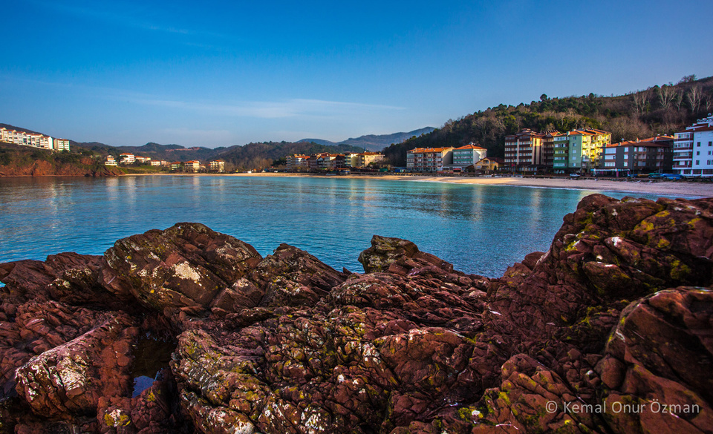
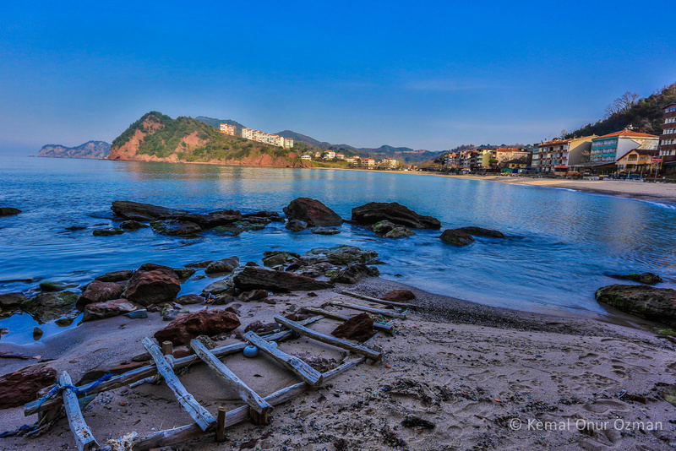
✈️Historical and Touristic Places
🏖️ Çakraz Beach
Overview:
Çakraz Beach is renowned for its serene atmosphere, clear turquoise waters, and a 1.5 km stretch of sandy shoreline. Surrounded by lush pine forests, it offers a tranquil escape from urban life.
Facilities:
The beach is equipped with essential amenities, including restrooms, sunbeds, umbrellas, and beach bars, ensuring a comfortable visit for all guests.
Activities:
Ideal for swimming, sunbathing, and leisurely walks along the shore, Çakraz Beach is also a popular spot for camping enthusiasts, with several campsites available in the vicinity.
Transportation: To reach Çakraz from Bartın, you can take a minibus (dolmuş) from the Bartın city center to Amasra. From Amasra, local minibuses or taxis can take you to Çakraz. The total journey time is approximately 45 minutes to 1 hour.
BARTIN

Slide 18
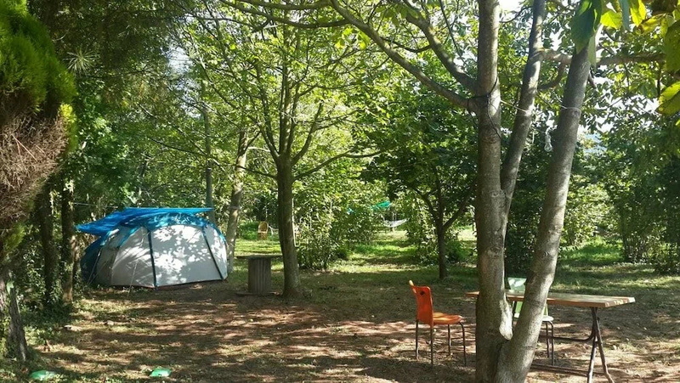
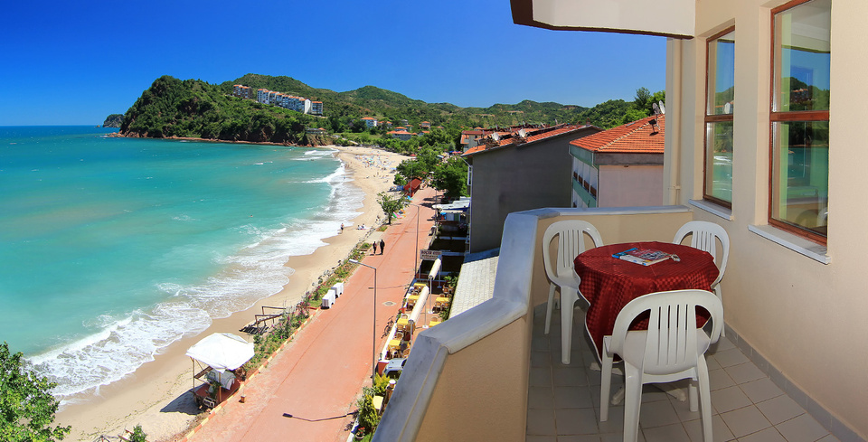
✈️Historical and Touristic Places
🏕️ Çakraz Beach - Camping and Accommodation
Camping:
Çakraz is a favored destination for camping, offering several campsites nestled amidst pine forests, providing a perfect blend of nature and comfort.
Accommodation:
The village boasts a variety of accommodations, including family-run guesthouses and boutique hotels, offering authentic Turkish hospitality.
BARTIN

Slide 19
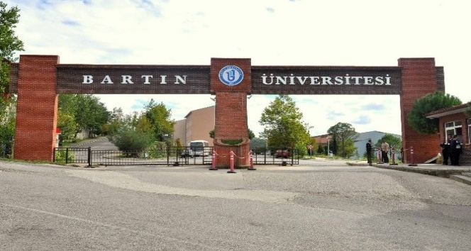


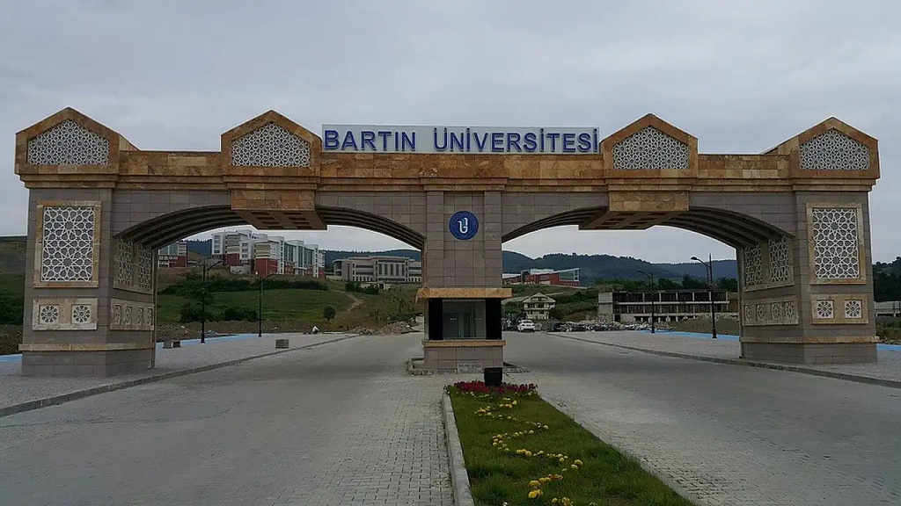


BARTIN UNIVERSITY
ERASMUS OFFICE
+90 378 223 5435/5437/5438
https://erasmus.bartin.edu.tr/
international@personel.bartin.edu.tr
Kutlubey Yazıcılar Yerleşkesi, Rektörlük Binası 74100 Merkez / Bartın

Slide 20
BARTIN UNIVERSITY
Thank You
We hope this guide helps you settle in smoothly. If you have any questions or concerns, don’t hesitate to reach out to the Erasmus Office or your mentor student.
✨ Enjoy your Erasmus journey in Bartın!
Warm regards,
Bartın University Erasmus Team

